Slide 1
Convolutional Neural Network Based Algorithm for Early Warning Proactive System Security in Software Defined Networks
Team No: 961CS-A17
Project Team
SL.No | Name | Roll no
1 | Siravena Raj Ganesh | 160717733308
2 | Syed Imad Uddin | 160717733309
3 | Thakur Sachin Singh | 160717733311
Under the guidance of Ms.P.M.Tulasi
Assistant Professor
Department of CSE
Project coordinater
Mr.M.Krishnamurty
Assistant Professor
Department of CSE

Slide 2
Abstract:
Cyber attack detection can identify unknown attacks from network traffics and has been an effective means of network security.
Nowadays, existing methods for network anomaly detection are usually based on traditional machine learning models, such as KNN, SVM, etc.
Although these methods can obtain some outstanding features, they get a relatively low accuracy and rely heavily on manual design of traffic features
. To solve the problems of low accuracy and feature engineering in Early Warning Proactive System Security in Software Defined Networks detection, a traffic anomaly detection model is proposed. The cyber attack detection model uses CNN and Liner Regression classifier algorithms for better efficiency in prediction.

Slide 3
Introduction :
Early Warning Proactive System Security in Software Defined Networks detection plays an important part in ensuring network information security. However, with the explosive growth of Internet business, traffic types in the network are increasing day by day, and network behaviour characteristics are becoming increasingly complex, which brings great challenges to Early Warning Proactive System Security in Software Defined Networks detection.
How to identify various malicious network traffics, especially unexpected malicious network traffics, is a key problem that cannot be avoided.

Slide 4
Objectives :
Cyber attack detection can be considered as a classification problem. By improving the performance of classifiers in effectively identifying malicious traffics, intrusion detection accuracy can be largely improved. Machine learning methods have been widely used in intrusion detection to identify malicious traffic.
However, these methods belong to shallow learning and often emphasize feature engineering and selection. They have difficulty in features selection and cannot effectively solve the massive intrusion data classification problem.

Slide 5
LITERATURE SURVEY – Paper 1
S.No. | Paper | Findings | Disadvantages
1 | Title: A Deep Learning Approach for Intrusion Detection Using Recurrent Neural Networks Author: CHUANLONG YIN, YUEFEI ZHU, JINLONG FEI, XINZHENG HE Journal: IEEE Year of Publication: 2017 | A deep learning approach for intrusion detection using recurrent neural networks (RNN-IDS) The performance of the model is studied in binary classification and multiclass classification. The experimental results show that RNN-IDS is very suitable for modeling a classification model with high accuracy. | The number of neurons and different learning rate impacts on the performance of the proposed model. Higher training time with higher GPU utilization.

Slide 6
LITERATURE SURVEY – Paper 2
S.No. | Paper | Findings | Disadvantages
2 | Title: A Novel Intrusion Detection Model for a Massive Network Using Convolutional Neural Networks Author: KEHE WU, ZUGE CHEN, WEI LI Journal: IEEE Year of Publication: 2018 | A novel network intrusion detection model utilizing convolutional neural networks (CNNs). The model not only reduces the false alarm rate (FAR) but also improves the accuracy of the class with small numbers. The calculation cost is further reduced by converting the raw traffic vector format into image format. | Lower detection accuracy. Lower performance. High resource utilization for performing calculations.

Slide 7
LITERATURE SURVEY – Paper 3
S.No. | Paper | Findings | Disadvantages
3 | Title: Pattern matching of signature-based IDS using Myers algorithm under MapReduce framework Author: Monther Aldwairi1, Ansam M. Abu-Dalo, Moath Jarrah Journal: EURASIP Journal on Information Security Year of Publication: 2017 | A bit-vector algorithm, Myers algorithm, is parallelized on a multi-core CPU under the MapReduce framework. On average, four times speedup is achieved using multi-core implementations when compared to the serial version. Two implementations of MapReduce are used to parallelize the Myers algorithm using Phoenix++ and MAPCG. | Many other frameworks exist that have better performance than MapReduce. Lower In-memory sharing can lead to lower performance.

Slide 8
Existing System :
In existing methods network packet sniffing tools are used to track in coming packets and analyse these packets to get find out secure packets and attacked packets.
Methods like Anti phishing tools administration settings , firewall settings are mainly used for detecting incoming packets.
In machine learning Naive bayes, Decision tree algorithms where used to predict cyber attacks

Slide 9
Disadvantages
Existing methods are old techniques which use manual settings which are supported to certain extent to protect from cyber attacks.
Most of these methods can not automate process of prediction.
Time and resources required for more for handling attacks.

Slide 10
Proposed System :
We propose an end-to-end Machine Learning based cyber attack detection method that is composed of Linear Regression and other Machine Learning Algorithms. Linear Regression can well solve the problem of intrusion detection and provide a new research method for intrusion detection.
We train model using linear regression model and predict packet is malicious or not based on user input.
We evaluate our proposed network with a real NSL-KDD dataset.
We compare accuracy of multiple machine learning models and find accuracy of each model. In proposed system along with Linear Regression Deep Learning Model is used to train dataset.

Slide 11
Advantages
This method helps organizations to train data set of any company and use trained model as basic security layer to take input of each packet data and predict if that is attacker or not
Machine learning Model accuracy is more compare to existing method.
Time taken for processing is less compare to existing methods.

Slide 12
Software & Hardware Requirements :
Hardware Requirements :
Hard disk : 128GB or above
Ram : 4GB
Processer : Intel core i3 or above
Software Requirements :
Coding Language : HTML, JavaScript
Operating System : WINDOWS XP/7/10
IDE : Anaconda prompt
Dataset : NSL-KDD dataset

Slide 13
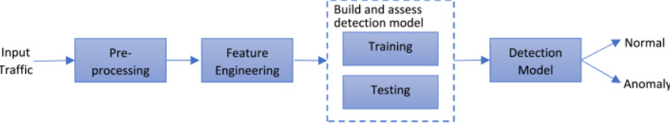
System Architecture:

Slide 14
Modules Implementation
Dataset Collection: In this step data set is collected from Kaggle website. Data set has features and labels. Features are used as input and labels for output.
DATA PREPROCESSING:
In this step data is pre processed by removing unwanted data and NAN values and using features and labels which are useful to fit in to algorithm and then process data for prediction.
Data split Test training:
In this stage data is divided in to test and train values using train test split function and store features and labels in to test train values. Train set is 30 percent of test set data which is used for checking accuracy of the dataset.

Slide 15
Model Training:
In this stage different algorithms are used to check which algorithm provides best accuracy and select one algorithm to use that for fitting features and labels and then run algorithm in this way model is trained.
Prediction and accuracy:
In this stage new input or test set is taken as input and given as input to predict function of the algorithm and then result of labels are as output of the algorithm.

Slide 16
CNN Algorithm
(1) Enter a NSK KDD Dataset. The pictures are extracted from the folder
as a training sample set for input.
(2) Pre-processing. In order to improve the training efficiency, the input image is standardized to a
resolution of 224 * 224.
(3) Construct new and improved models. using the sequential model, the 3 FC layers are
optimized as 1 Flatten layer and 2 FC layers with reduced parameters. Replace the Softmax
classification layer of the original model with a 2-label Softmax classifier.

Slide 17
(4) Micro-transfer learning. Using the parameters of the 16 convolutional layers and pooling layers
of the sequential pre-trained model, the parameters of the detection model were optimized by transfer
learning.
(5) Model training. To train and optimize the parameters of 2 FC layers and Softmax layers, it is
necessary to freeze the parameters of 16 convolutional layers and their pooling layers and initialize the
model parameters using a random method, set the momentum parameters, the learning rate, and the
accuracy standard to iterate.

Slide 18
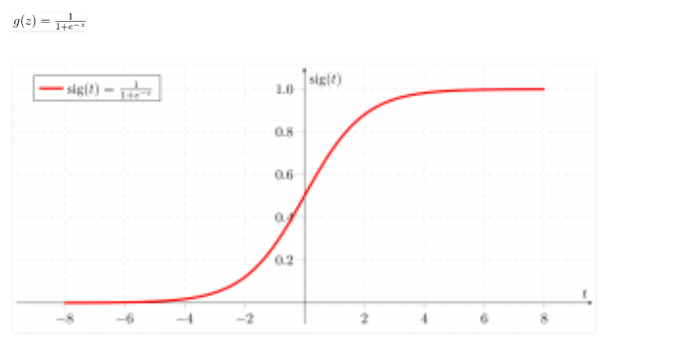
ALGORITHM
Logistic regression is basically a supervised classification algorithm. In a classification problem, the target variable(or output), y, can take only discrete values for a given set of features(or inputs), X. Contrary to popular belief, logistic regression IS a regression model. The model builds a regression model to predict the probability that a given data entry belongs to the category numbered as “1”. Just like Linear regression assumes that the data follows a linear function, Logistic regression models the data using the sigmoid function.

Slide 19
Logistic regression becomes a classification technique only when a decision threshold is brought into the picture. The setting of the threshold value is a very important aspect of Logistic regression and is dependent on the classification problem itself. The decision for the value of the threshold value is majorly affected by the values of precision and recall. Ideally, we want both precision and recall to be 1, but this seldom is the case.
binomial: target variable can have only 2 possible types: “0” or “1” which may represent “win” vs “loss”, “pass” vs “fail”, “dead” vs “alive”, etc.
multinomial: target variable can have 3 or more possible types which are not ordered(i.e. types have no quantitative significance) like “disease A” vs “disease B” vs “disease C”.
ordinal: it deals with target variables with ordered categories. For example, a test score can be categorized as:“very poor”, “poor”, “good”, “very good”. Here, each category can be given a score like 0, 1, 2, 3.
First of all, we explore the simplest form of Logistic Regression, i.e Binomial Logistic Regression.

Slide 20
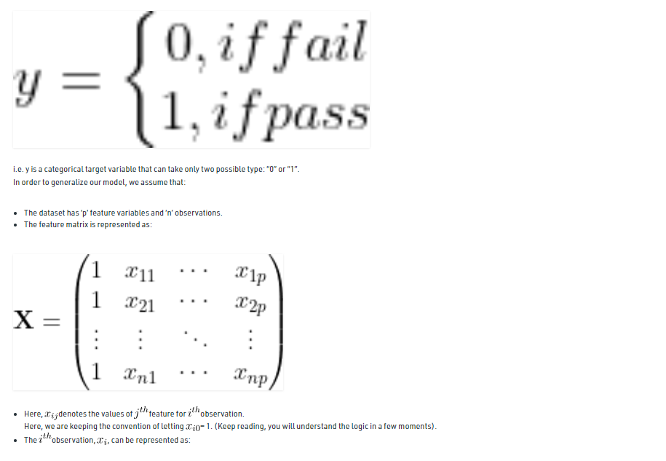

Slide 21
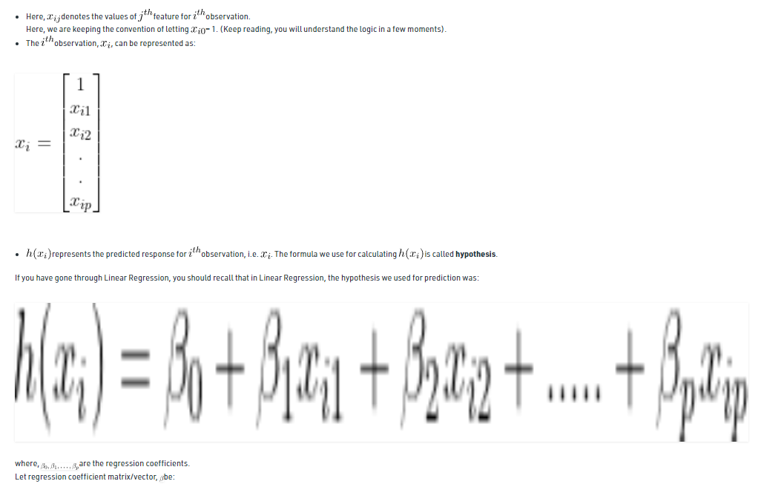

Slide 22
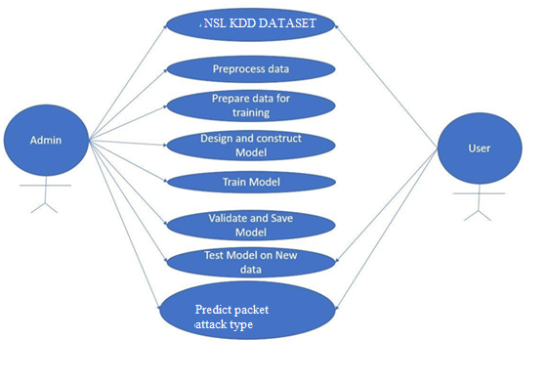
ANALYSIS AND DESIGN Use Case Diagram

Slide 23
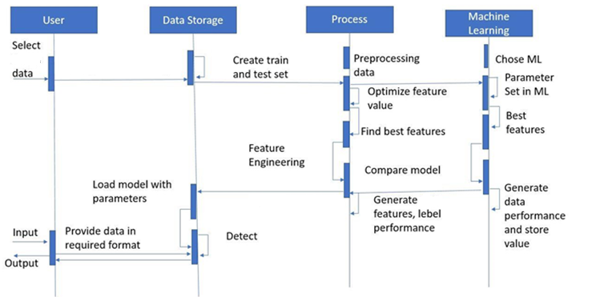
SEQUENCE DIAGRAMS

Slide 24
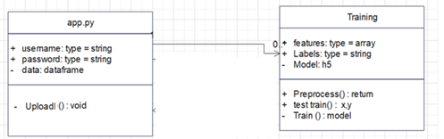
Class Diagram

Slide 25
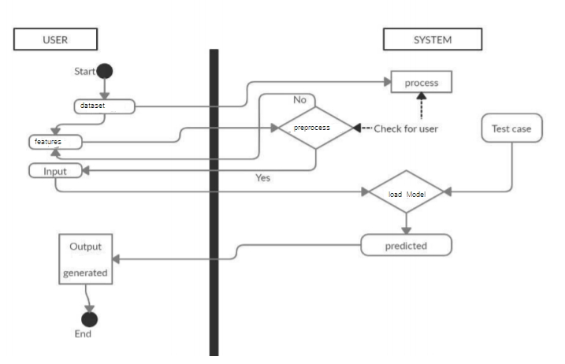
Activity Diagram

Slide 26
Conclusion
The current deep learning methods in the network traffic classification research don’t make full use of the network traffic structured information.
Drawing on the application methods of deep learning in the field of natural language processing, we propose a novel model BAT-MC via the two phase’s learning of Linear Regression & 3 Layer Neural Network and attention on the time series features for intrusion detection using NSL-KDD dataset.
Each data packet can produce a packet vector. These packet vectors are arranged to form a network flow vector. Attention layer is used to perform feature learning on the network flow vector composed of packet vectors.
The above feature learning process is automatically completed by deep neural network without any feature engineering technology.

Slide 27
Limitation and Future Scope
Regardless of whatever sliver of truth there may or may not be in Gartner’s prediction, two things are certain — intrusion detection is still a long way from being mature, and intrusion prevention technology is in its infancy. Massive changes are in store for both areas. There are some of the areas within intrusion detection and intrusion prevention in which substantial and beneficial progress is likely to occur. These areas include the following:
The continued reduction in reliance on signatures in intrusion detection
The growth of intrusion prevention
Advances in data correlation and alert correlation methods
Advances in source determination
Inclusion of integrated forensics functionality in IDSs and IPSs
Greater use of honeypots

Slide 28
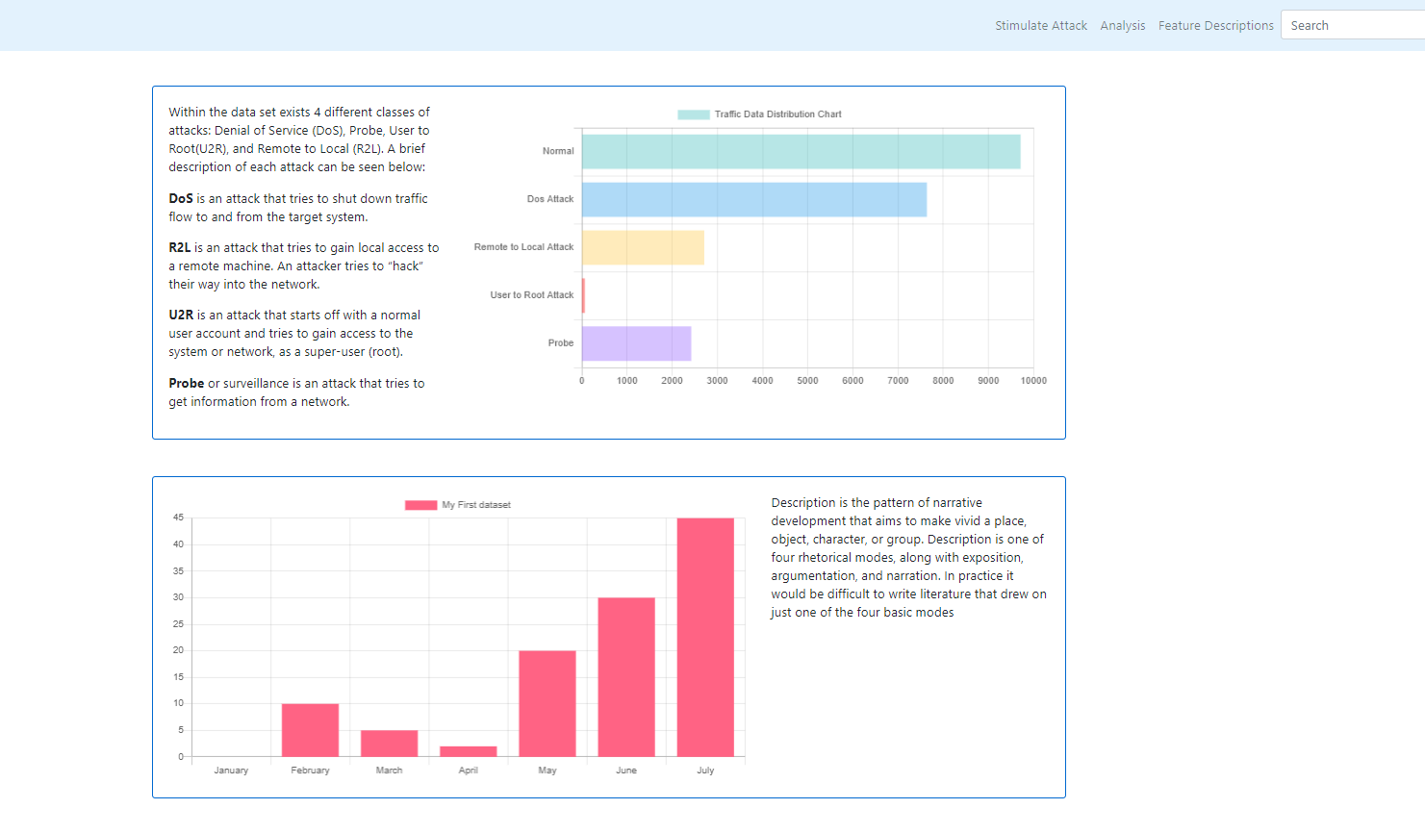
Result and Discussion

Slide 29

Data Set Features

Slide 30
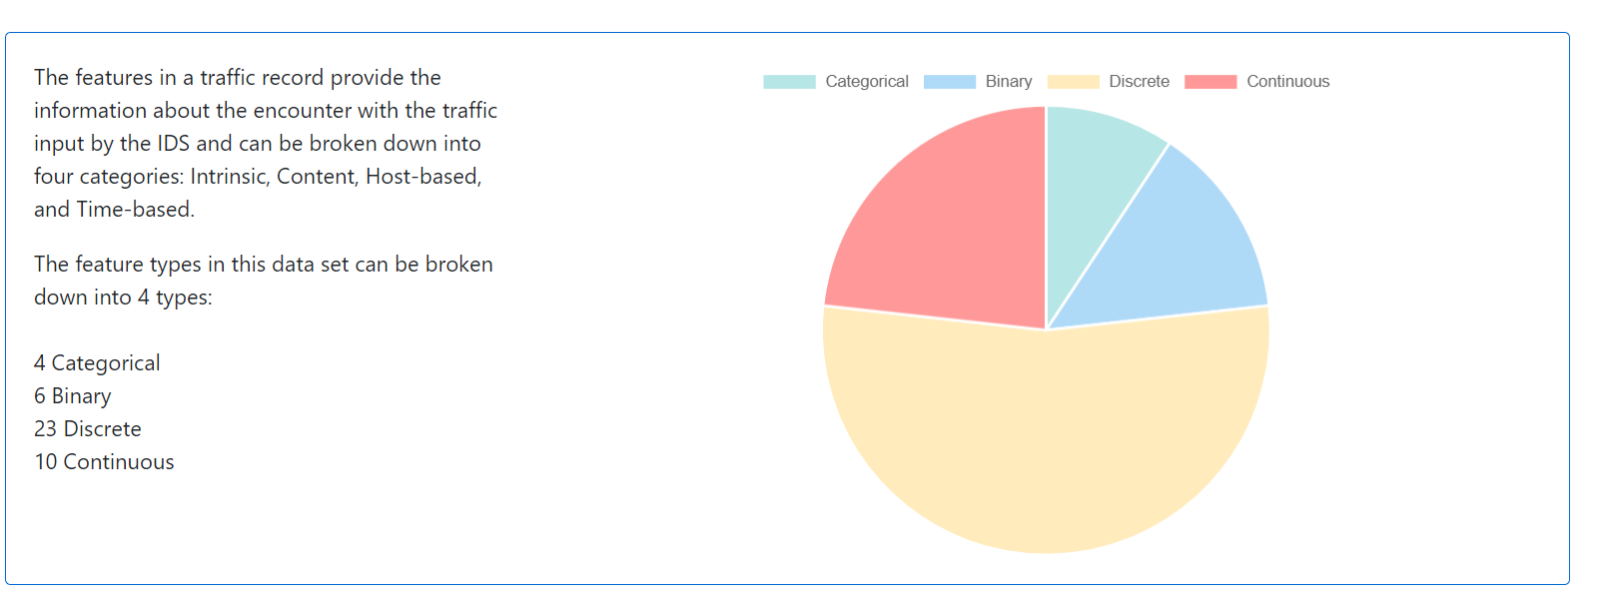
Dataset Analysis

Slide 31
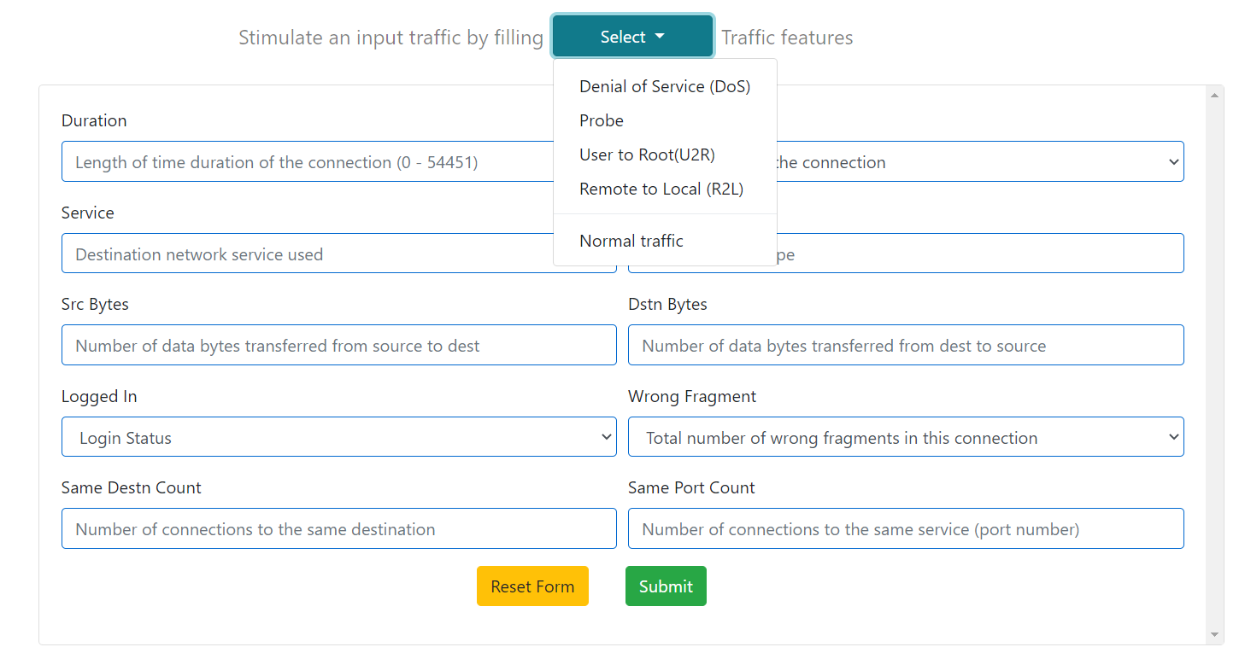
Data Input

Slide 32
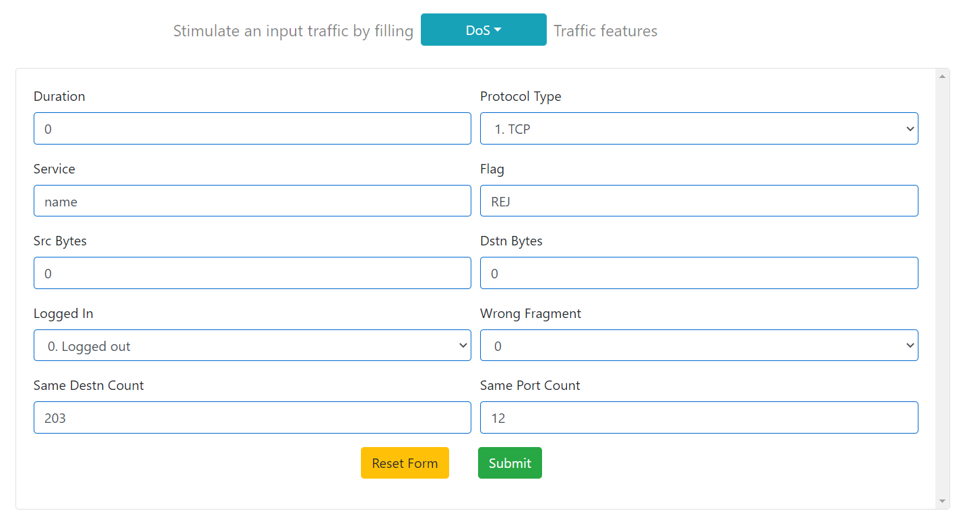
Data Input

Slide 33
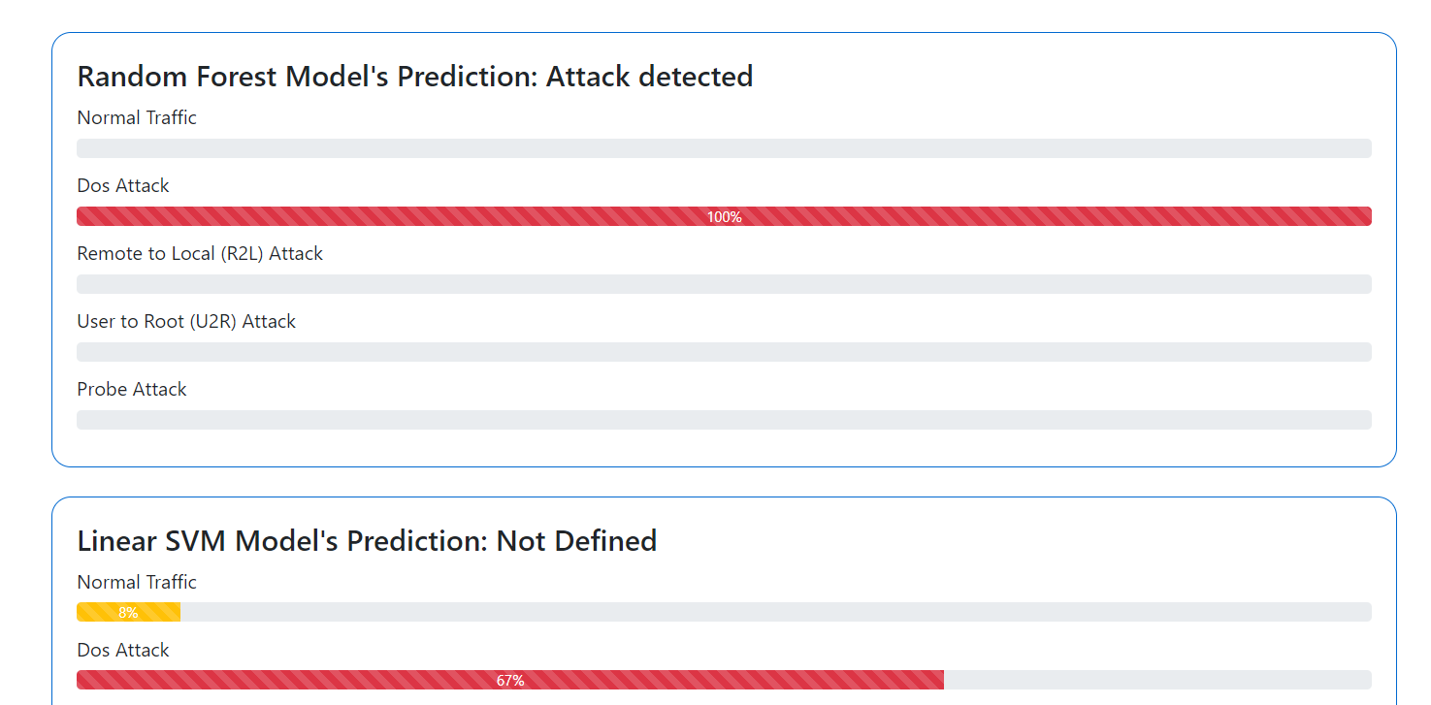
Result type of attack

Slide 34
References:
B. B. Zarpelo, R. S Miani, C. T. Kawakani, and S. C. de Alvarenga, ‘‘A survey of intrusion detection in Internet of Things,’’ J. Netw. Comput. Appl., vol. 84, pp. 25–37, Apr. 2017.
[2] B. Mukherjee, L. T. Heberlein, and K. N. Levitt, ‘‘Network intrusion detection,’’ IEEE Netw., vol. 8, no. 3, pp. 26–41, May 1994.
[3] S. Kishorwagh, V. K. Pachghare, and S. R. Kolhe, ‘‘Survey on intrusion detection system using machine learning techniques,’’ Int. J. Control Automat., vol. 78, no. 16, pp. 30–37, Sep. 2013.
[4] N. Sultana, N. Chilamkurti, W. Peng, and R. Alhadad, ‘‘Survey on SDN based network intrusion detection system using machine learning approaches,’’ Peer-to-Peer Netw. Appl., vol. 12, no. 2, pp. 493–501, Mar. 2019.
[5] M. Panda, A. Abraham, S. Das, and M. R. Patra, ‘‘Network intrusion detection system: A machine learning approach,’’ Intell. Decis. Technol., vol. 5, no. 4, pp. 347–356, 2011.

Slide 35
Bibliography
B. B. Zarpelo, R. S Miani, C. T. Kawakani, and S. C. de Alvarenga, ‘‘A survey of intrusion detection in Internet of Things,’’ J. Netw. Comput. Appl., vol. 84, pp. 25–37, Apr. 2017.
B. Mukherjee, L. T. Heberlein, and K. N. Levitt, ‘‘Network intrusion detection,’’ IEEE Netw., vol. 8, no. 3, pp. 26–41, May 1994.
S. Kishorwagh, V. K. Pachghare, and S. R. Kolhe, ‘‘Survey on intrusion detection system using machine learning techniques,’’ Int. J. Control Automat., vol. 78, no. 16, pp. 30–37, Sep. 2013.
N. Sultana, N. Chilamkurti, W. Peng, and R. Alhadad, ‘‘Survey on SDN based network intrusion detection system using machine learning approaches,’’ Peer-to-Peer Netw. Appl., vol. 12, no. 2, pp. 493–501, Mar. 2019.
M. Panda, A. Abraham, S. Das, and M. R. Patra, ‘‘Network intrusion detection system: A machine learning approach,’’ Intell. Decis. Technol., vol. 5, no. 4, pp. 347–356, 2011.
W. Li, P. Yi, Y. Wu, L. Pan, and J. Li, ‘‘A new intrusion detection system based on KNN classification algorithm in wireless sensor network,’’ J. Electr. Comput. Eng., vol. 2014, pp. 1–8, Jun. 2014.

